Slide 1
Conceptual short-term memory and the richness of experience
Henry Shevlin CUNY Graduate Center
ASSC 19
Paris, July 2015

Slide 2
Conceptual short-term memory and the richness of experience
A distinction between theories of consciousness
(2) Richness and ephemerality
(3) Conceptual Short-Term Memory
(4) CSTM and consciousness

Slide 3
A distinction between theories of consciousness
I’ll begin by drawing a distinguish between cognitive and sensory theories of consciousness
What I’ll term cognitive accounts take perceptual phenomenology to constitutively involve cognitive access.
On this view, part of what it is for a state to be conscious is for its content to be thought about, noticed, or otherwise cognitively accessed by the subject.
Examples: global neuronal workspace, higher-order thought theory, Dennettian ‘fame in the brain’, etc..

Slide 4
A distinction between theories of consciousness
By contrast, what I’ll call sensory accounts of consciousness take perceptual phenomenology to be independent of cognitive access.
Thus a state might be phenomenally conscious even though its contents are not thought about, noticed, or otherwise cognitively accessed by the subject.
Defenders of this kind of view include Block (2007, 2015), Burge (2006), and Lamme (2006).

Slide 5
An advantage of cognitive accounts
One advantage of cognitive accounts is that can capture the intuitive link between a state’s being well integrated into a subject’s mental life and its being conscious.
They can thus explain the important link between mental states being conscious and their being available for report.
By contrast, because defenders of sensory accounts deny any constitutive role for cognitive access in consciousness, they seemingly have to allow for some very counterintuitive possibilites.

Slide 6
An advantage of cognitive accounts
These include the possibility of conscious perceptions that might greatly alter a subject’s phenomenal landscape despite being wholly or partially inaccessible.
Even more drastically, it raises the possibility of conscious pains that a subject would not (or could not) notice or think about (Burge 2006, Weisburg 2011).
Offsetting this advantage, however, sensory theories have the edge on cognitive theories when it comes to what I’ll call richness and ephemerality.

Slide 7
Conceptual short-term memory and the richness of experience
A distinction between theories of consciousness
(2) Richness and ephemerality
(3) Conceptual Short-Term Memory
(4) CSTM and consciousness

Slide 8
Richness and ephemerality
When we’re in Times Square, we feel overwhelmed by all the sights, sounds, and smells. It feels like we’re perceptually conscious of more than we consciously notice or think about.

Slide 9
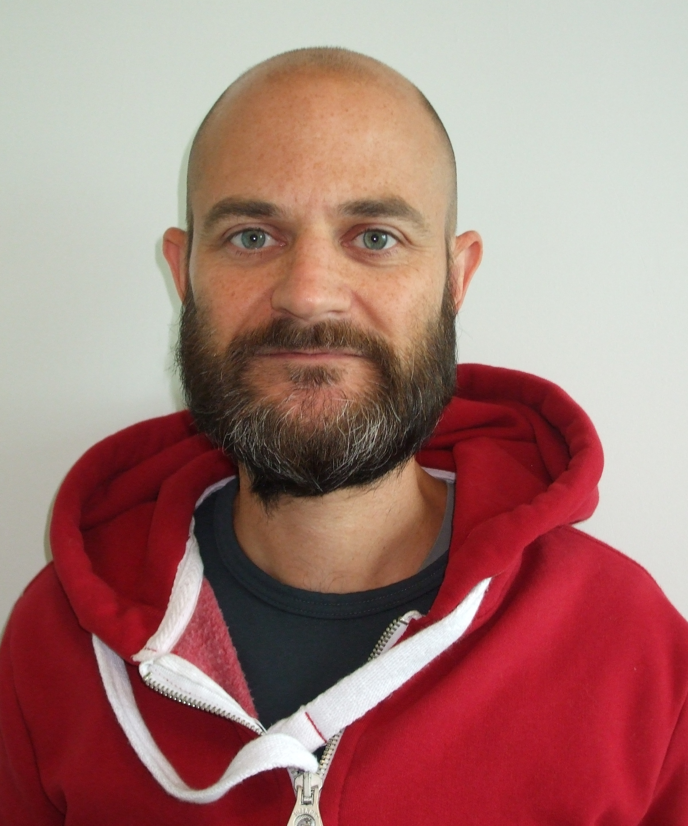
Richness
It’s tempting to think something like is also true in more mundane environments; I might be talking animatedly to an old friend and fail to notice his new beard, yet it’s intuitive to think I still consciously see it.

Slide 10
Richness
Richness is a problem for cognitive theories of consciousness because the familiar mechanisms of cognition seem to have strict capacity limits.
Conscious working memory, for example, is limited to just 4-5 items. The global neuronal workspace is also highly capacity limited, making us conscious of just one thing at a time (Dehaene 2014).
These mechanisms seem too austere to explain richness. By contrast, sensory theories can appeal to high capacity sensory stores like Iconic Memory (Sperling 1960) and Fragile Visual Short Term Memory (Sligte 2008).

Slide 11
Ephemerality
A closely related point is the ephemerality of perceptual phenomenology. It seems like most of what we experience is present to us only very briefly.
If I see a complex image, then just a few seconds later, I’ll only remember its rough details: far less than seemed to feature in my conscious experience when I saw it.

Slide 12
Ephemerality
However, most cognitive mechanisms allow us to retain information for prolonged periods – several minutes, in some cases.
Again, sensory theorists seem to have the edge in explaining this phenomenon - mechanisms like iconic memory and fragile visual short term memory have durations of a few seconds at most.
This corresponds to the seemingly very brief ‘phenomenal half-life’ of the representations in perceptual experience.

Slide 13
A cognitive answer to richness?
One way to preserve a broadly cognitive account of consciousness while accommodating these intuitions would be to propose an additional layer of conscious cognitive processing.
Specifically, we would need a kind of high capacity, very short term, fragile visual short term memory that was clearly at the level of cognition rather than perception.
Evidence for just such a mechanism comes from Mary Potter’s work on Conceptual Short Term Memory.

Slide 14
Conceptual short-term memory and the richness of experience
A distinction between theories of consciousness
(2) Richness and ephemerality
(3) Conceptual Short-Term Memory
(4) CSTM and consciousness

Slide 15
Conceptual short-term memory
I’ll now consider the evidence for CSTM. It comes from a wide of experiments mostly led by Mary Potter at MIT.
In one experiment, subjects saw a rapid serial visual presentation sentence with each word presented for 133ms. At one point, subjects briefly saw a pair of words shown simultaneously.
Subject’s task was to pick the contextually appropriate word and repeat back the whole sentence.

Slide 16
Conceptual short-term memory
Subjects could easily complete this task but they were unable to recall the word whose meaning they had rejected, even though they presumably must have understood its meaning in order to reject it.
This experiment seems to demonstrate that high level conceptual information about visual stimuli is accessed extremely rapidly and almost immediately forgotten unless consolidated
However, it remains possible that this is a working memory effect. More recent work of Potter’s is harder to explain in these terms.

Slide 17
Conceptual short-term memory
The most compelling trials involve rapidly serially presented pictures. Subjects see a sequence of images and are cued either before or afterwards to look out for an image that fits a given description (e.g., a wedding).
In a recent 2014 study, subjects saw 6-12 novel images for durations of 13, 27, 53, or 80ms.
They were given a target high-level description (for example, “a wedding” or “flowers”) either 900ms before or 200ms after presentation, and asked whether any of the images matched that description.
In some trials where they were indeed shown an image matching the description provided, they were then shown two images and asked to indicate which of them was the one they had seen.

Slide 18
Conceptual short-term memory
Subjects do well at these tasks, suggesting they conceptualize and store images very rapidly. In a recent (2014) study, for example, subjects saw 6-12 novel images for durations of 13, 27, 53, or 80ms.
They were given a target high-level description (e.g., “a wedding” or “flowers”) either 900ms before or 200ms after presentation, and asked whether any of the images matched that description.
In some trials where they were shown an image matching the description provided, they were then asked to indicate which of two images was the one they had seen.

Slide 19
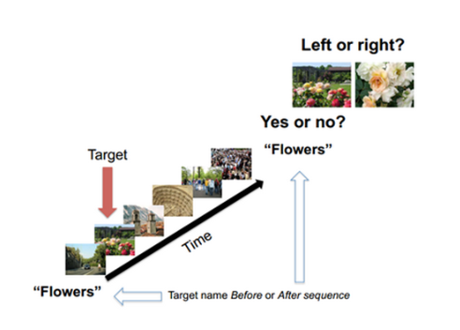
Conceptual short-term memory
From Potter et al. 2014.

Slide 20
Conceptual short-term memory
In all trials, detection was well above chance, including those trials where subjects were cued immediately after presentation of the images.
In the forced choice tasks, subjects were well above chance in identifying the image that had been presented iff they had successfully detected it under the relevant description.
Finally, subjects who were shown just 6 images rather than 12 performed better in general, but all subjects performed at well above chance levels on all measures.

Slide 21
Why is this surprising?
First, note that subjects presumably had to conceptually classify all presented images in order to ascertain whether any of them matched the target description.
Second, they were able to accurately say of any of them whether it fit the target description even when cued after presentation.
This means that they retained 6-12 representations in some kind of short term memory. This exceeds the capacity of visual working memory, so must some other memory mechanism.

Slide 22
Could the effect be iconic memory?
Could subjects just be retaining multiple iconic representations which they were able to very rapidly 'inspect' to see whether they met the target description?
This is unlikely- first,all known forms of visual sensory memory are vulnerable to disruption by the subsequent presentation of distinct images in the same location, but that's a basic feature of RSVP paradigms.
Moreover, if subjects were indeed engaged in this sort of inference, then one would expect them to sometimes fail the detection task but succeed in the subsequent recognition task.

Slide 23
Characteristics of CSTM
Potter's work suggests a few features of CSTM.
CSTM is fast, automatic, and involuntary. It seems to involve conceptual contents, including high level features of objects and scenes.
Its capacity is larger than working memory's, and unlike sensory memory, isn't disrupted by serially presented information. It’s extremely fragile and decays reapidly
It's open for debate whether CSTM is conscious. However, in some paradigms subjects think they retained a brief memory of multiple pictures.

Slide 24
Conceptual short-term memory and the richness of experience
A distinction between theories of consciousness
(2) Richness and ephemerality
(3) Conceptual Short-Term Memory
(4) CSTM and consciousness

Slide 25
CSTM and Consciousness
If we assume that CSTM provides the psychological basis for perceptual phenomenology, what might follow?
CSTM involves conceptual representation, including sophisticated learned concepts like ‘wedding’ or ‘picnic’ and typically seems to be accessible to working memory.
It thus allows us to preserve the key insights of cognitive theories: only representations that reach this level of processing would be candidates for being conscious, so non-integrated or inaccessible sensory states would not contribute to perceptual phenomenology.

Slide 26
CSTM and Consciousness
At the same time, it would provide a very straightforward explanation for the phenomena of richness and ephemerality.
A CSTM view of consciousness is also uniquely well-placed to accommodate some of the claimed high-level features of perceptual phenomenology.
I’ll quickly mention two of these, namely high-level content and gist.

Slide 27
CSTM and Consciousness
First, because the contents of CSTM include high level conceptual representations, it can neatly accommodate the idea that we have sophisticated phenomenological representation of things like causation, animacy, or specific individuals.
Second, it can neatly explain how we can have experiences with highly general ‘gist’ content; it’s hard to see how a strictly sensory view of perceptual phenomenology can accommodate experiences that are extremely non-specific (such as seeing “some animal or another”, or “some kind of natural scene”).

Slide 28
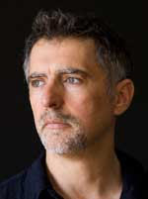
Conclusion
Research on CSTM is at an early stage and is ongoing. However, it’s already given us promising results, and it’s compatible with other approaches to consciousness.
For these reasons, I think it’s an exciting new direction in consciousness research.
THANK YOU!

